Slide 1
Module 2: Lesson 2 Hadoop Distributed File System Overview

Slide 2
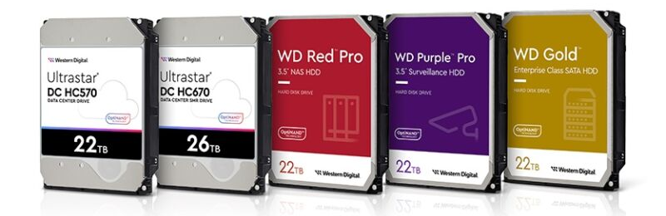
Big Data: Where Do We Store It? Our Ability to Store Data Physically is Improving
Western Digital HDD capacity hits 28TB as Seagate looks to 30TB and beyond

Slide 3
Big Data: Where to Store It? But How do We Organize Big Data For Effective Use?
Object (Blob) Store
A cloud storage service that efficiently manages vast amounts of data as individual objects (blobs of bytes) identified by unique keys or identifiers
Distributed File System
Software that allows multiple independent storage systems to be combined into a single larger virtual storage system allowing files larger than any individual storage system to be spread across the cluster
Data Lakes
A centralized repository (object store, distributed file system or “NewSQL” database) that allows storage of data at any scale, integrated with analytic tools enabling insight generation

Slide 4
Big Data: Where to Store It? But How do We Organize Big Data For Effective Use?
NoSQL Database
A database designed for the storage and retrieval of large volumes of data by executing across multiple compute and storage nodes
“NewSQL” Database
A database that combines the scalability and flexibility of NoSQL databases with the full SQL compliance of relational databases
Data Lakehouse
Hybrid data storage architecture that combines the flexibility and scalability of a data lake with the performance and governance of a SQL data warehouse.
Usually supports only a subset of the SQL query language compatible with high performance (excluding joins or similar operations

Slide 5
Distributed File Systems
When a dataset outgrows the storage capacity of a single physical machine or storage device…
It becomes necessary to partition storage across a number of separate machines or devices
File systems that manage storage across a cluster of machines are called distributed file systems
Distributed file systems are more complex (subject to more failure modes) than centralized ones
So the file system must tolerate node, storage and other failures without suffering data loss

Slide 6
Hadoop Distributed File System
Hadoop comes with a standard distributed file system
Hadoop Distributed File System (HDFS)
Provide fault tolerant and scalable data storage
Optimized for analysis of large and sometimes growing datasets of mostly unchanging records
Designed to work seamlessly with the MapReduce programming model
Data can only be written once and cannot be overwritten or modified (Write Once Read Many), ensuring data integrity and consistency, although new data can be appended to an existing file (Append Only)

Slide 7
Hadoop Distributed File System
HDFS supports a traditional hierarchical file organization similar to most other file systems such as for Linux, MacOS or Windows
Part of the default AWS Elastic Map Reduce (Hadoop) HDFS
directory hierarchy. Note the root direct is called “/” as it is for the MacOS and Linux directory hierarchies.
/
apps
temp
user
var
hadoop
history
hive
root
spark
warehouse
An application (or user) can create directories and then store files inside these directories or an application can create a child directory inside a parent directory and store files there
Read, write and execute security permissions can be associate with each file or directory
An application (or user) can create, remove, rename or move files from one HDFS directory to another.
And special operations exist for exchanging files between HDFS and a local (Linux, Windows or MacOS) filesystem

Slide 8
Mapping the Generic Distributed File System to HDFS
Generic Distributed File System
Hadoop Distributed File System
App
Hadoop Cluster
(HDFS View)
HDFS Client
Obtain Metadata
Chunks
Blocks
NameNode
NameNode
Read and Write Blocks
Metadata
Metadata
Metadata Node(s)
NameNode(s)
Heartbeats, Block Reports, Block Mgmt.
DataNode
DataNode
DataNode
Data Node(s)
DataNode(s)
Blocks
Blocks
Blocks
Block Replication

Slide 9
Hadoop Distributed File System Architecture
An HDFS cluster has nodes executing one of two types of software daemons, NameNode(s) and DataNode(s), operating in a primary/worker pattern
App
Hadoop Cluster
(HDFS View)
HDFS Client
Obtain Metadata
Files in HDFS is divided into fixed-size blocks, typically 128MB in size distributed across the cluster's nodes for efficient storage and parallel processing
NameNode
NameNode
Read and Write Blocks
Metadata
Metadata
To ensure file availability and reliability, HDFS replicates file data blocks across multiple nodes, and associates a checksum with each block
Heartbeats, Block Reports, Block Mgmt.
DataNode
DataNode
DataNode
This replication strategy enables HDFS to continue operating even if some nodes fail, preventing data loss and maintaining system resilience.
Blocks
Blocks
Blocks
Block Replication

Slide 10
Hadoop Distributed File System Benefits
Stores Large Files:
Millions of files of gigabytes, terabytes, or petabytes in size
Integration with Hadoop Ecosystem:
HDFS integrates with other components of the Hadoop ecosystem, such as MapReduce, Hive, and Spark
Economic Storage:
Using commodity hardware or virtual machines instead of expensive, high-end equipment, HDFS can reduce the cost of data storage
Data Locality:
To reduce the amount of network traffic, HDFS tries to satisfy a read request from a replica that is closest to the reader
High Throughput Data Access:
HDFS is designed to provide high throughput data access, enabling it to handle large data transfers efficiently
Fault Tolerance:
HDFS is designed to continue operating without disruption even when some nodes or storage media fail or some data is corrupted
Scalability:
The distributed architecture of HDFS allows adding more storage capable nodes to the cluster as data volumes increase

Slide 11
Hadoop Distributed File System Limitations
Inefficiency for Small Files:
HDFS overhead, including metadata storage and block management, becomes significant for small files, leading to performance degradation
Limits on Total Number of Files::
File system metadata is stored in memory and not distributed across nodes and this puts an upper bound on the total number of files about which information can be stored
Inadequacy for Low-Latency Applications:
Applications requiring low latency (<10ms) access to data will not work well due to Namenode overhead to obtain file metadata
Transactional Interactions:
Single writer per file
No updates allowed to already written data
Lack of Real-Time Data Processing Capabilities:
HDFS is not designed for real-time data processing, where data is ingested, processed, and analyzed as it arrives.
Complexity in Managing Large Clusters:
Managing large HDFS clusters can be challenging due to resource utilization monitoring, node failure detection, and data integrity across numerous nodes.

Slide 12
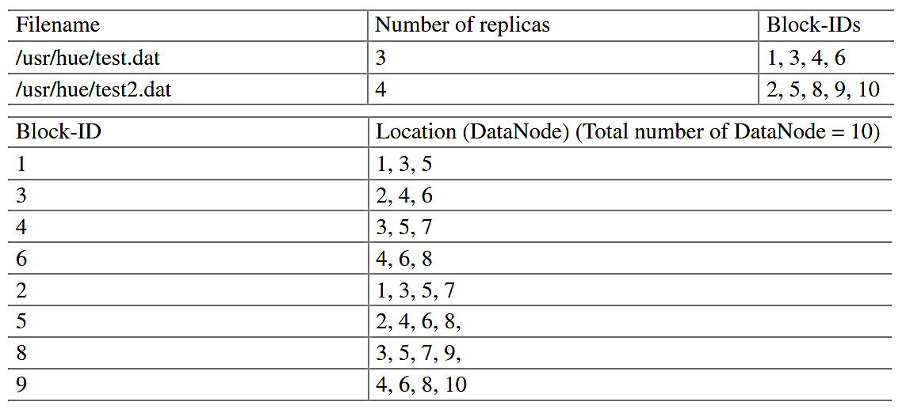
Hadoop Distributed File System NameNode(s)
Cluster node(s) which execute the NameNode daemon that manages the filesystem namespace
App
Hadoop Cluster
(HDFS View)
HDFS Client
Obtain Metadata
NameNode
NameNode
Maintain the file system directory tree, file system access permissions and file system block location data
Read and Write Blocks
Metadata
Metadata
Heartbeats, Block Reports, Block Mgmt.
Keeps metadata in memory for fast access and also stores the metadata on disk for reliability
DataNode
DataNode
DataNode
Tracks the health of the DataNode(s) and will not refer to any request to inactive DataNode(s)
Blocks
Blocks
Blocks
Block Replication

Slide 13
Hadoop Distributed File System DataNode(s)
Cluster node(s) which execute the DataNode daemon that stores and retrieves blocks at the request of an HDFS client or NameNodes(s)
App
Hadoop Cluster
(HDFS View)
HDFS Client
Obtain Metadata
Blocks are stored as regular files on the local filesystem and each DataNode reports back to the NameNode as to what blocks it is holding
NameNode
NameNode
Read and Write Blocks
Metadata
Metadata
Each DataNode sends a heartbeat message to the NameNode to indicate it is still alive
Heartbeats, Block Reports, Block Mgmt.
DataNode
DataNode
DataNode
DataNode(s) work together with the NameNode(s) to replicate blocks
Blocks
Blocks
Blocks
Block Replication

Slide 14
Hadoop Distributed File System Client
Supports interaction with HDFS on behalf of an application by communicating with NameNode(s) and DataNode(s)
App
Hadoop Cluster
(HDFS View)
HDFS Client
Obtain Metadata
Communicates with the NameNode to obtain block (and DataNode) location information
NameNode
NameNode
Read and Write Blocks
Metadata
Metadata
Communicates with DataNode(s) to read and write block data
Heartbeats, Block Reports, Block Mgmt.
DataNode
DataNode
DataNode
Incorporates error handling mechanisms to deal with node failures, data corruption, network disruptions, and other potential issues to maintain data availability and integrity
Blocks
Blocks
Blocks
Block Replication

Slide 15
Hadoop Distributed File System Blocks
HDFS stores files as one or more blocks, generally defaulting to 128Mb in size to minimize the cost of seeking to the block versus the time to read it from storage media
Rather than store the blocks of a file on one node the blocks are spread across nodes so HDFS can support files larger than the largest single disk available in the cluster
And file blocks distributed across the cluster can also be read in parallel increasing total I/O throughput
Normally a data node reads blocks from persistent storage but frequently accessed blocks may be cached explicitly in memory, for improved data access performance
Each file block is usually duplicated twice for a total of three copies (default replication factor of 3). Replicated blocks are part of the mechanism allowing HDFS high availability and fault-tolerance

Slide 16
Hadoop Distributed File System Blocks
Assume we are using replication to support of fault tolerance, where the total amount of storage in a Hadoop cluster is 90TB and that HDFS block size is 128MB, and the replication factor is 3
If we have a file which is 542MB in size, how many blocks
will exist in HDFS when the file is stored ?
Round-up ( 542MB file size / 128MB block size) = 4 blocks
4 blocks * replication factor of 3 = 12 total blocks
What is the maximum total size of all files which can be
stored into the cluster?
90TB total storage / replication factor of 3 = 30TB
If we want to store 10TB of additional files, how much storage would we need to add to the cluster?
10TB of total files * replication factor of 3 = 30TB

Slide 17
HDFS Read (Simplified)
Client connects to NameNode to read file data
1
NameNode tells client where to find the data blocks
2
Client reads blocks directly from DataNode(s) (without going through NameNode)
3
In case of node failures, client connects to another node that serves the missing block
4

Slide 18
HDFS Read (Simplified)
Why does HDFS choose such a design for read? Why not ask client to read blocks through NameNode?
Prevent NameNode from being the bottleneck of the cluster
Allow HDFS to scale to large number of concurrent clients
Spread the data traffic across the cluster

Slide 19
HDFS Write (Simplified)
Client connects to the NameNode to create a file
1
NameNode provides the client with a list of DataNodes to which to write file blocks
2
Client writes a block directly to an initial DataNode which replicates the block onto other DataNodes
3
Each DataNode propagates acknowledgement of receiving a block back to its sender
4
And the initial DataNode propagates acknowledgement back to the client
5
Repeats until the client finishes writing all file blocks at which point the client indicates write completion to the NameNode
6

